Slide 1
Q&A

Slide 2
How to put parental controls on consoles

Slide 3
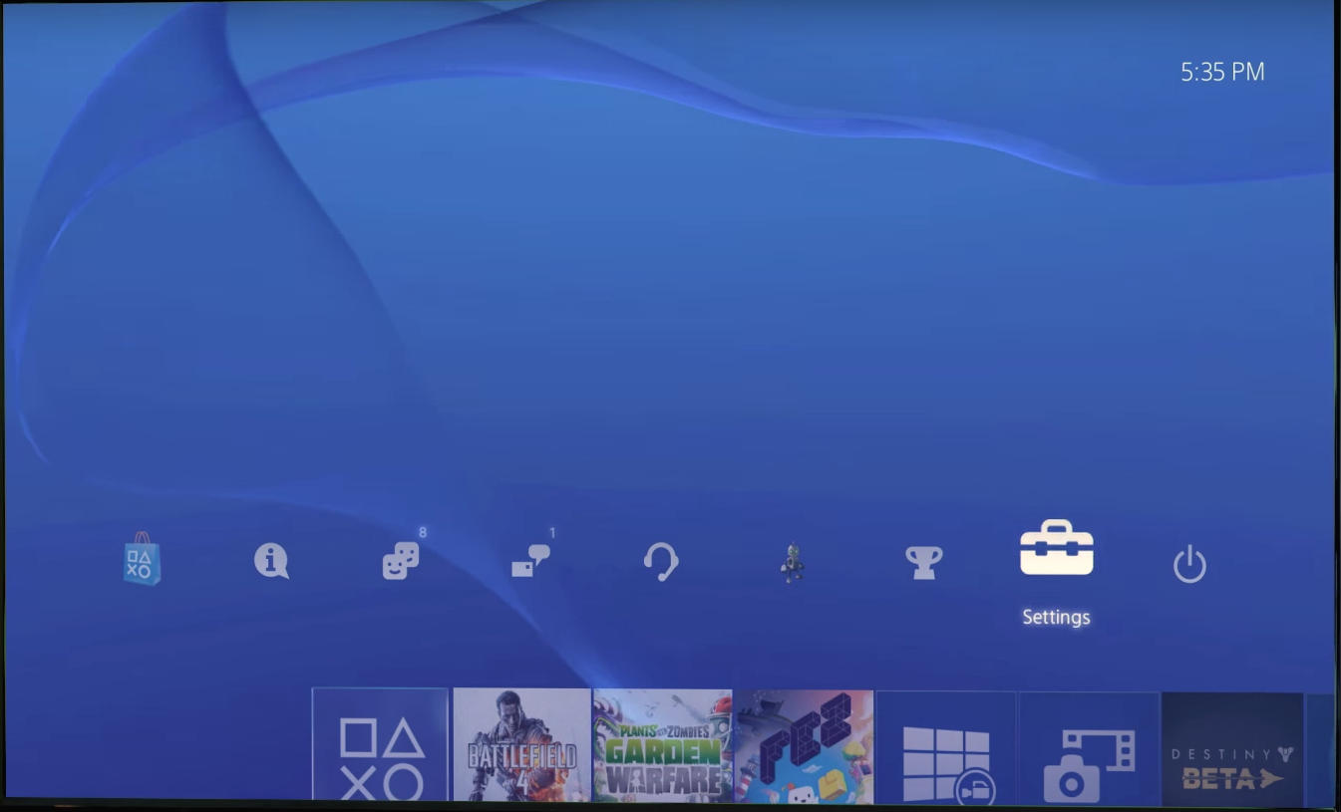
How to put parental controls onto PlayStation 4

Slide 4
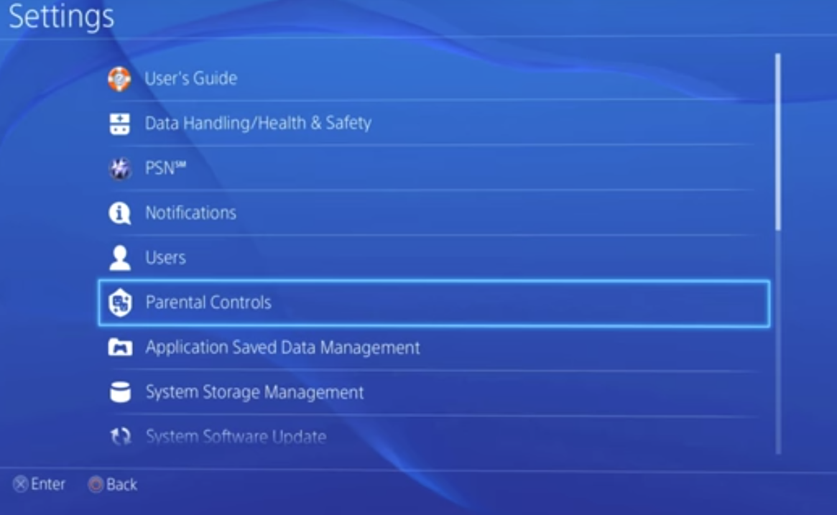
How to put parental controls onto PlayStation 4

Slide 5
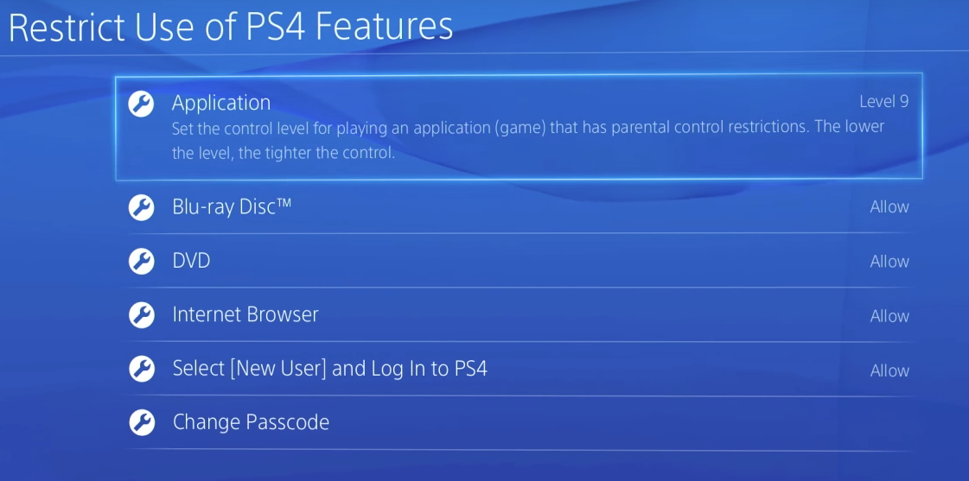
How to put parental controls onto PlayStation 4

Slide 6
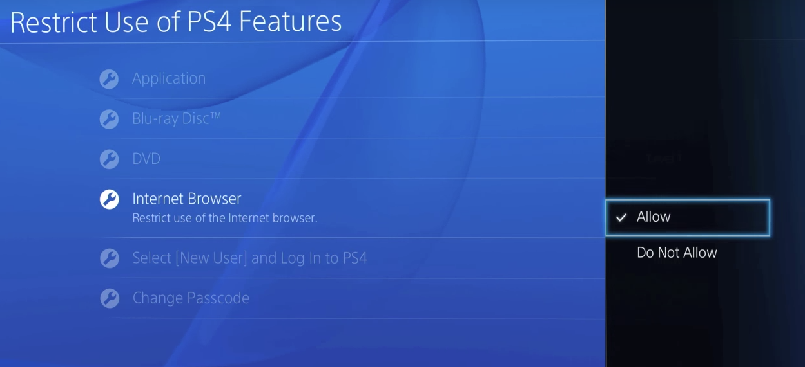
How to put parental controls onto PlayStation 4

Slide 7
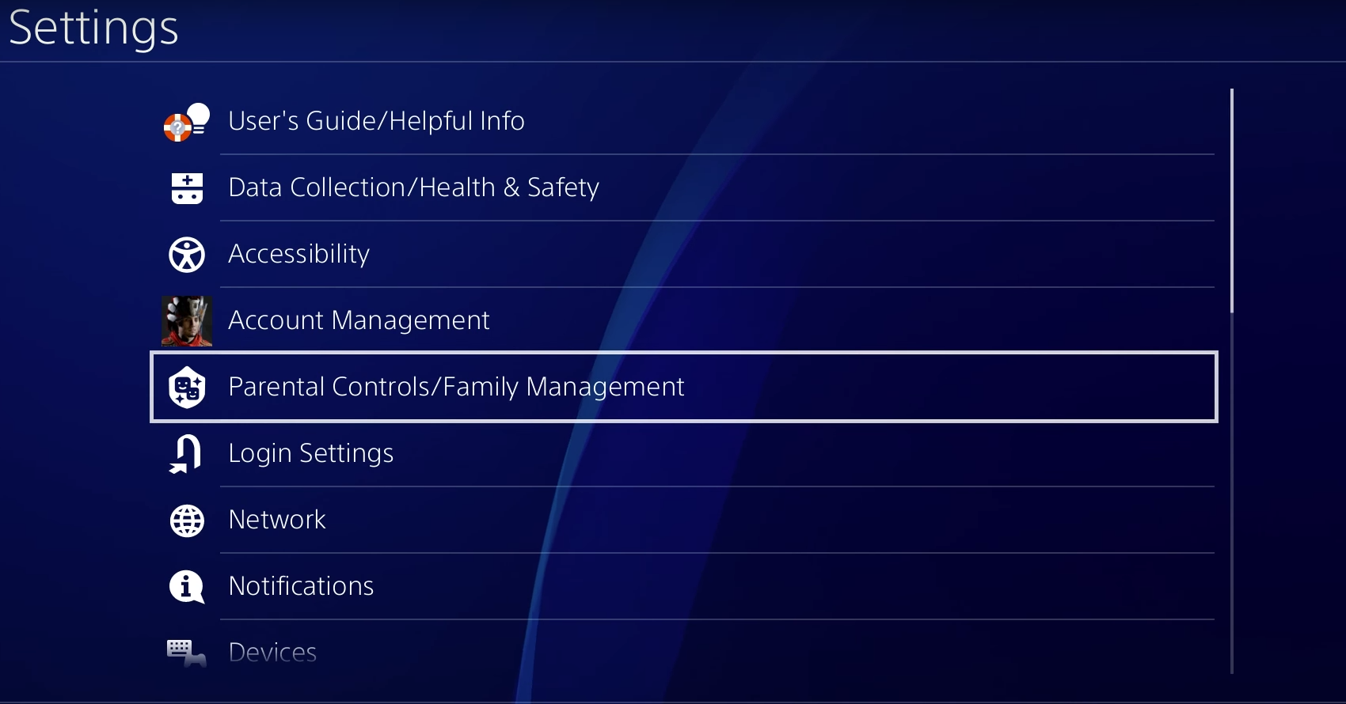
How to put parental controls onto PlayStation 4 (newest update)

Slide 8
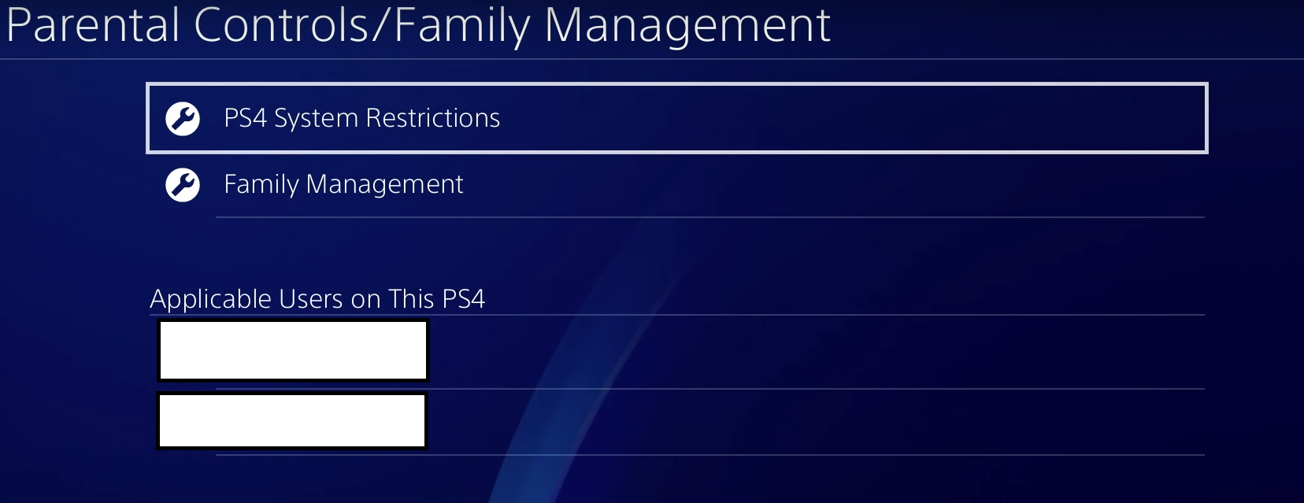
How to put parental controls onto PlayStation 4 (newest update)

Slide 9
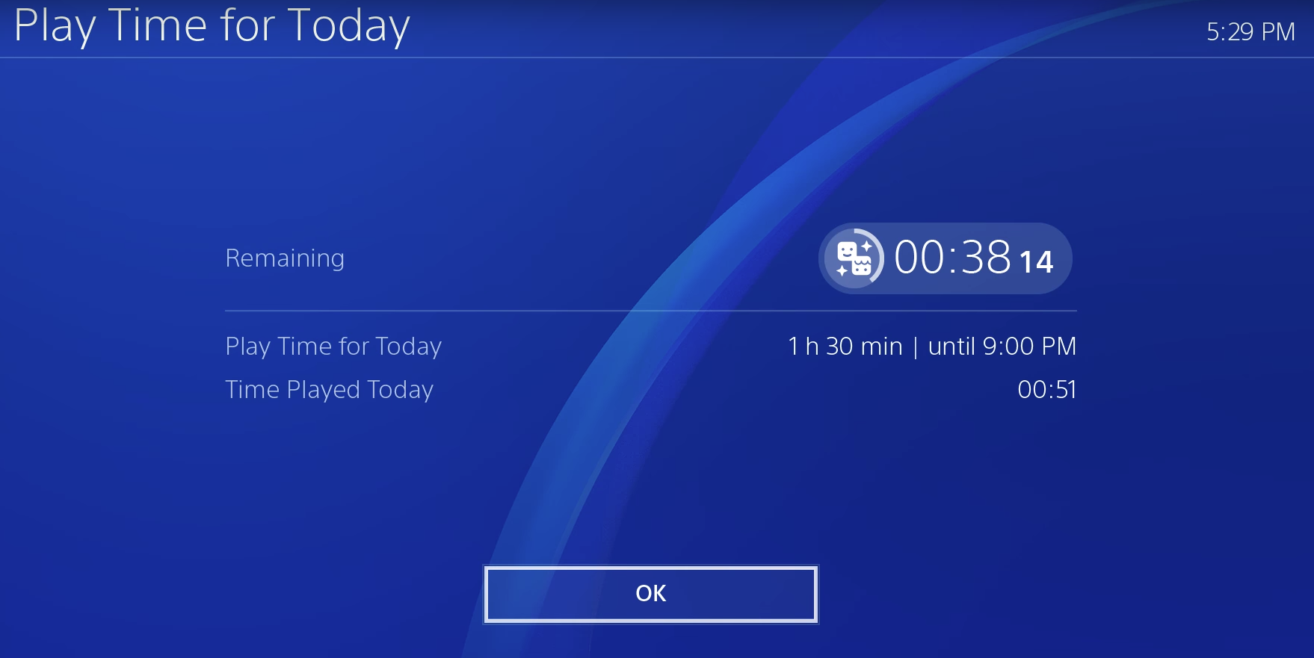
How to put parental controls onto PlayStation 4 (newest update)

Slide 10

How to put parental controls onto PlayStation 4 (newest update)

Slide 11
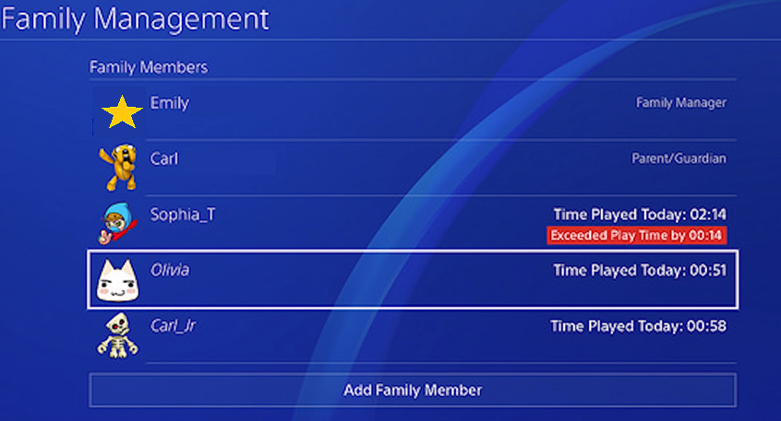
How to put parental controls onto PlayStation 4 (newest update)

Slide 12
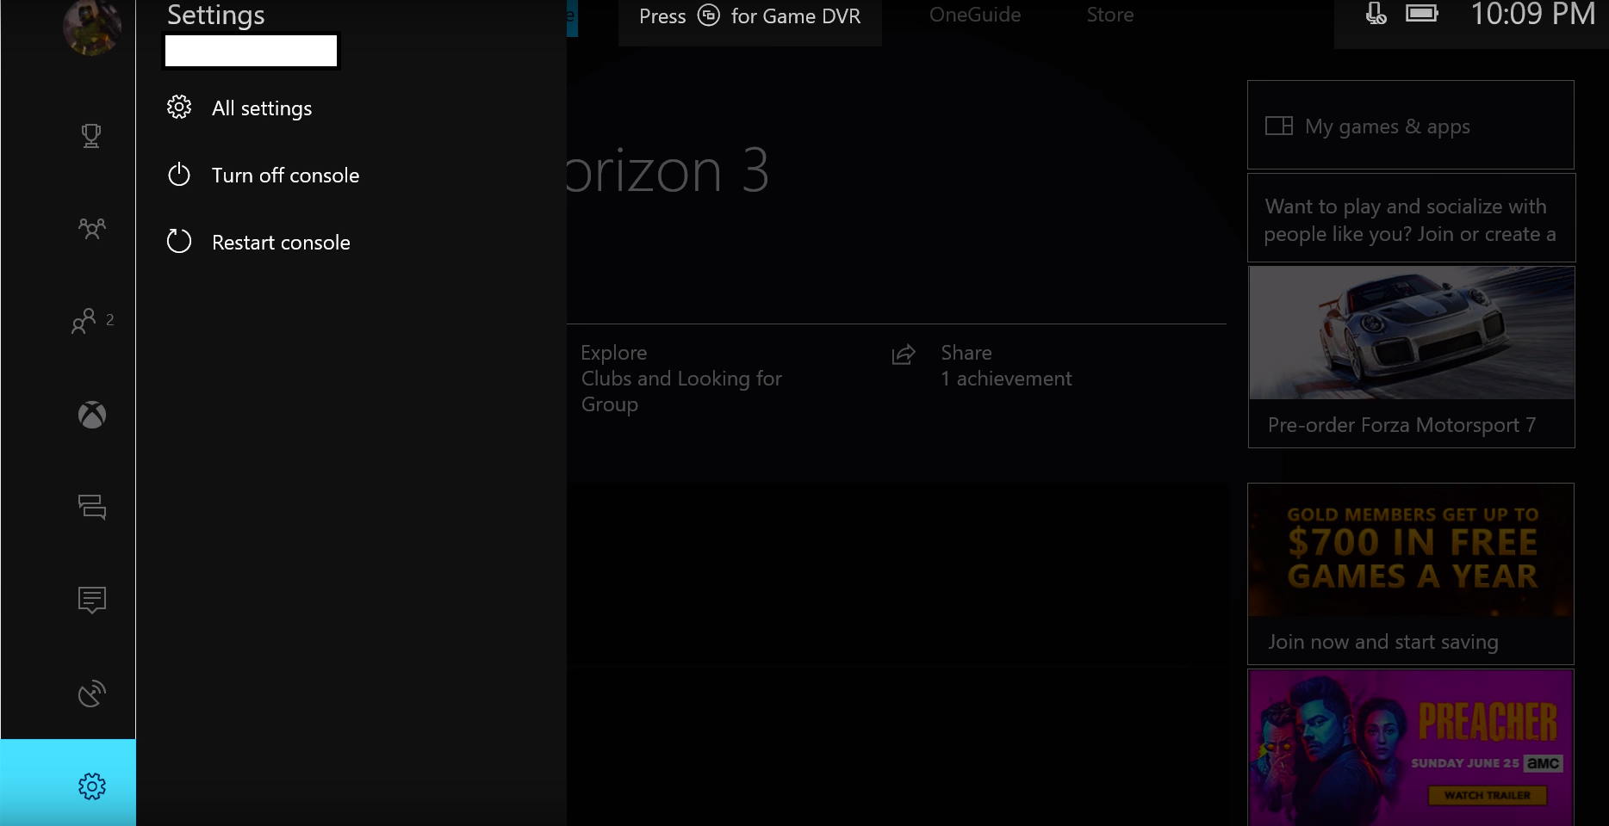
How to put parental controls onto Xbox

Slide 13
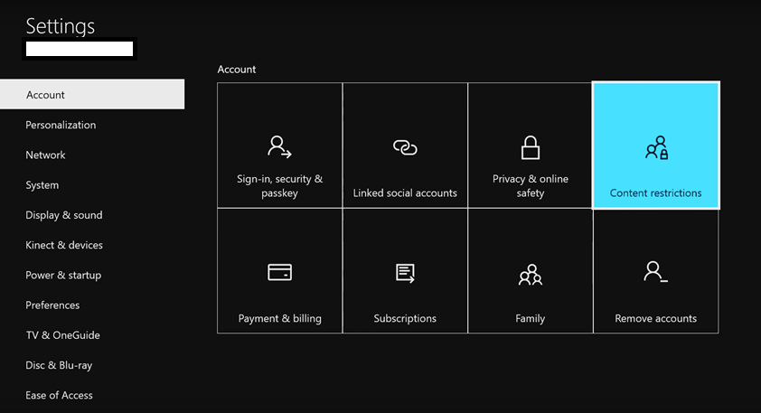
How to put parental controls onto Xbox

Slide 14
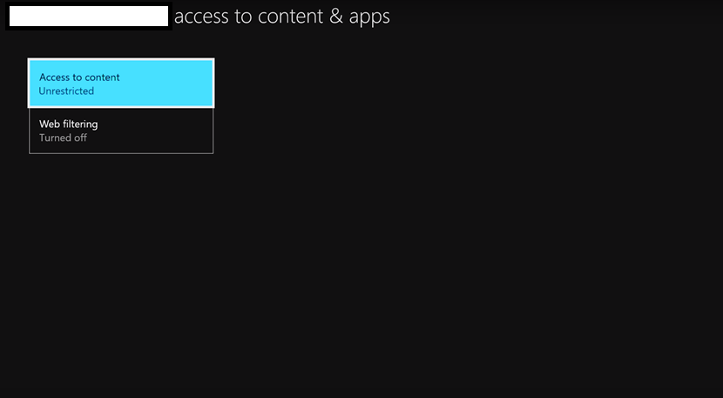
How to put parental controls onto Xbox

Slide 15
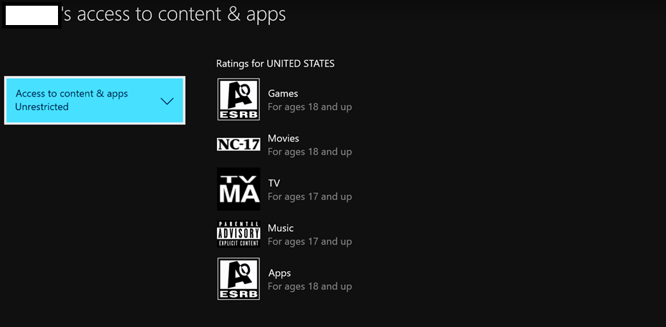
How to put parental controls onto Xbox

Slide 16
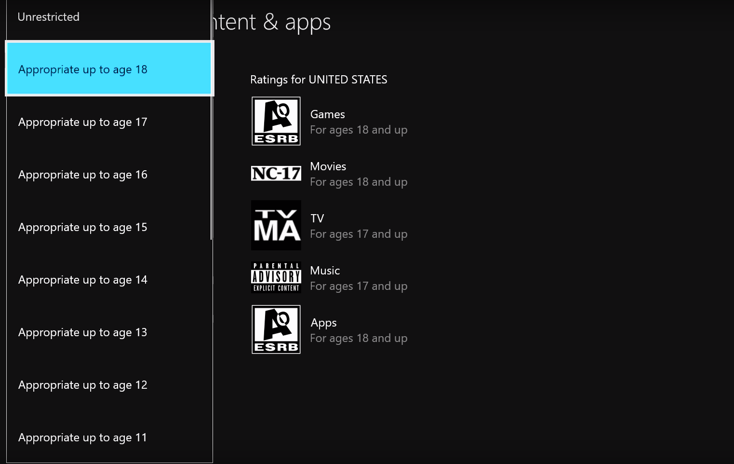
How to put parental controls onto Xbox

Slide 17
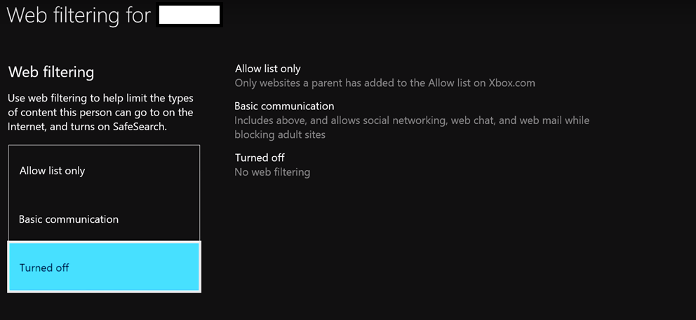
How to put parental controls onto Xbox

Slide 18
Parent guides for children’s apps

Slide 19
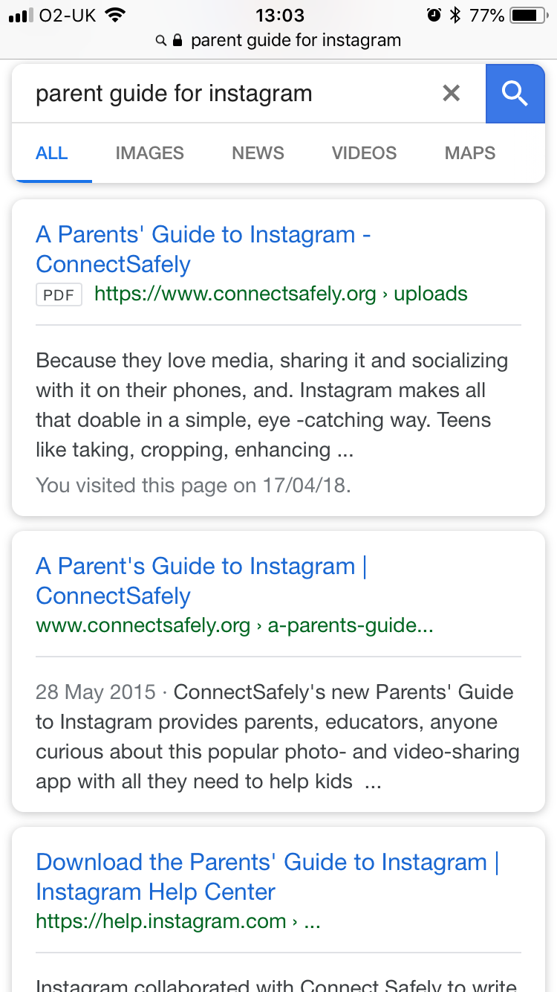
“For Parents” – Instagram
Google: ‘Parent guide for Instagram’
Select link pointed to ‘help.Instagram.com’

Slide 20
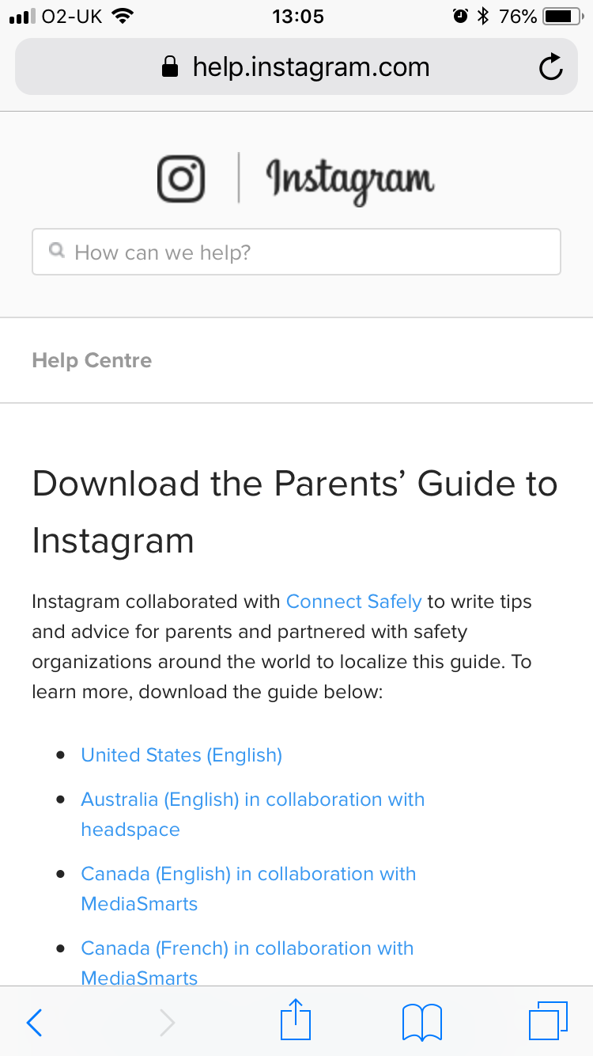
“For Parents” – Instagram
Google: Parent guide for Instagram
Select link pointed to ‘help.Instagram.com’
Should open main page

Slide 21
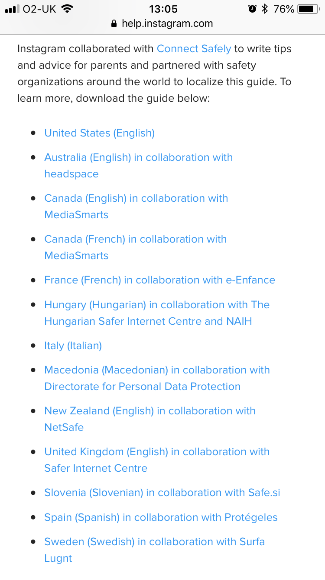
“For Parents” – Instagram
Google: Parent guide for Instagram
Select link pointed to ‘help.Instagram.com’
Should open main page
Scroll down and select United Kingdom (English)

Slide 22
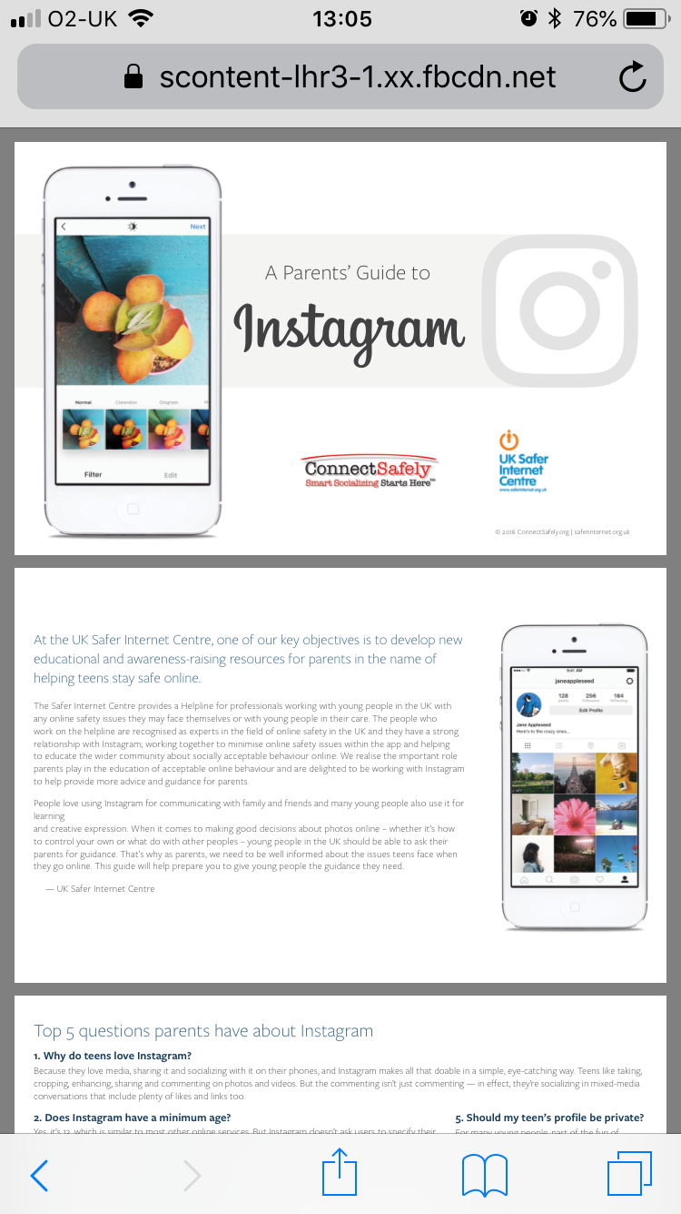
“For Parents” – Instagram
Google: Parent guide for Instagram
Select link pointed to ‘help.Instagram.com’
Should open main page
Scroll down and click on United Kingdom (English)
Bookmark page

Slide 23
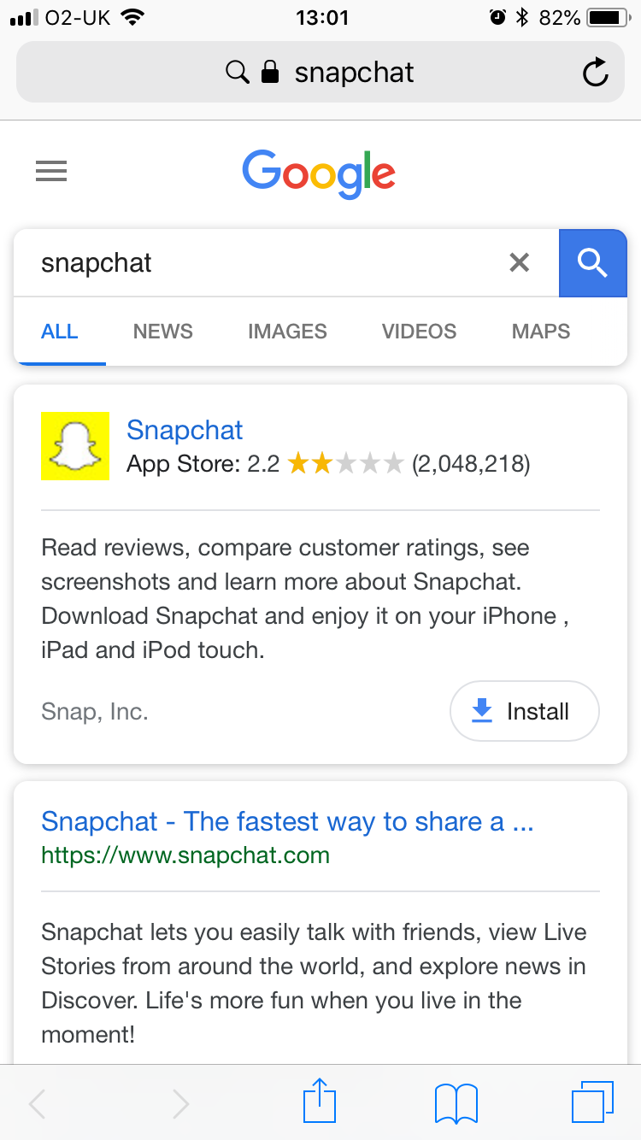
“For Parents” – Snapchat
Google: Snapchat
Select link pointed to ‘www.snapchat.com’

Slide 24
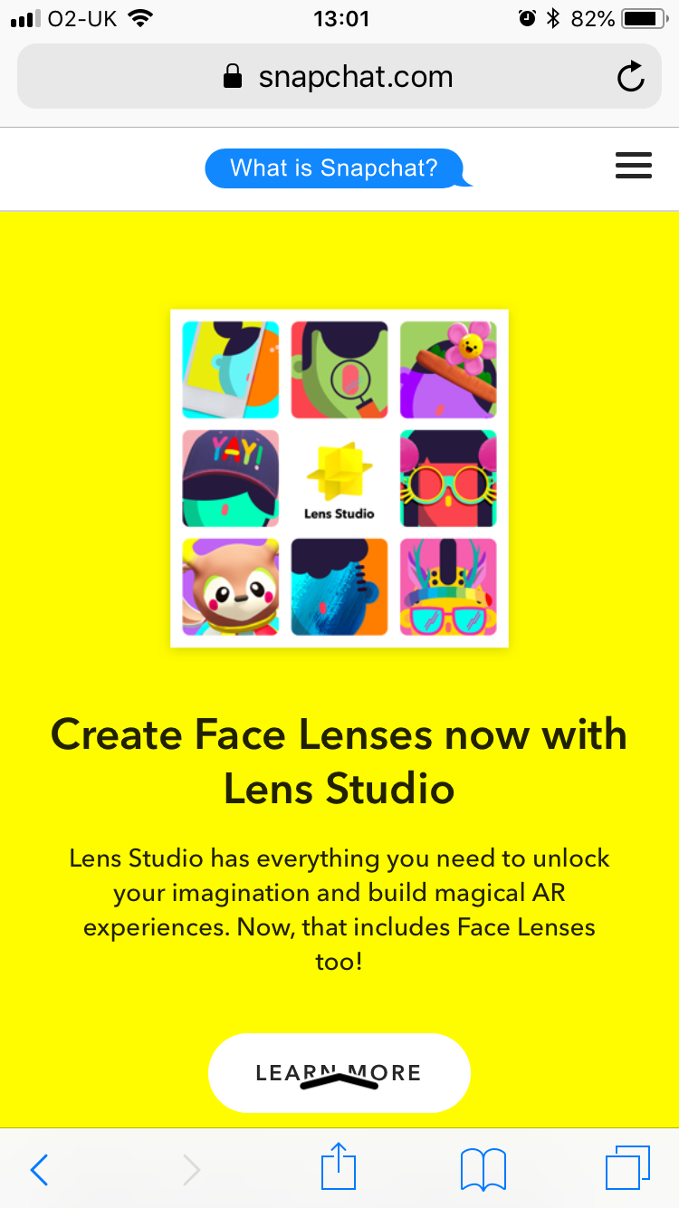
“For Parents” – Snapchat
Google: Snapchat
Select link pointed to ‘www.snapchat.com’
Scroll down

Slide 25
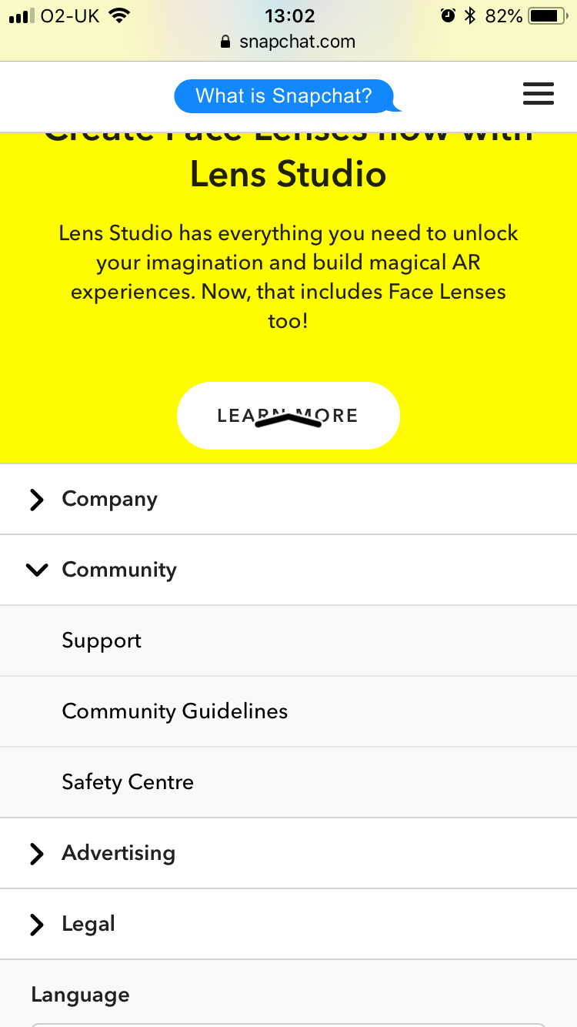
“For Parents” – Snapchat
Google: Snapchat
Select link pointed to ‘www.snapchat.com’
Scroll down
Click on ‘Community’
Select ‘Safety Centre’

Slide 26
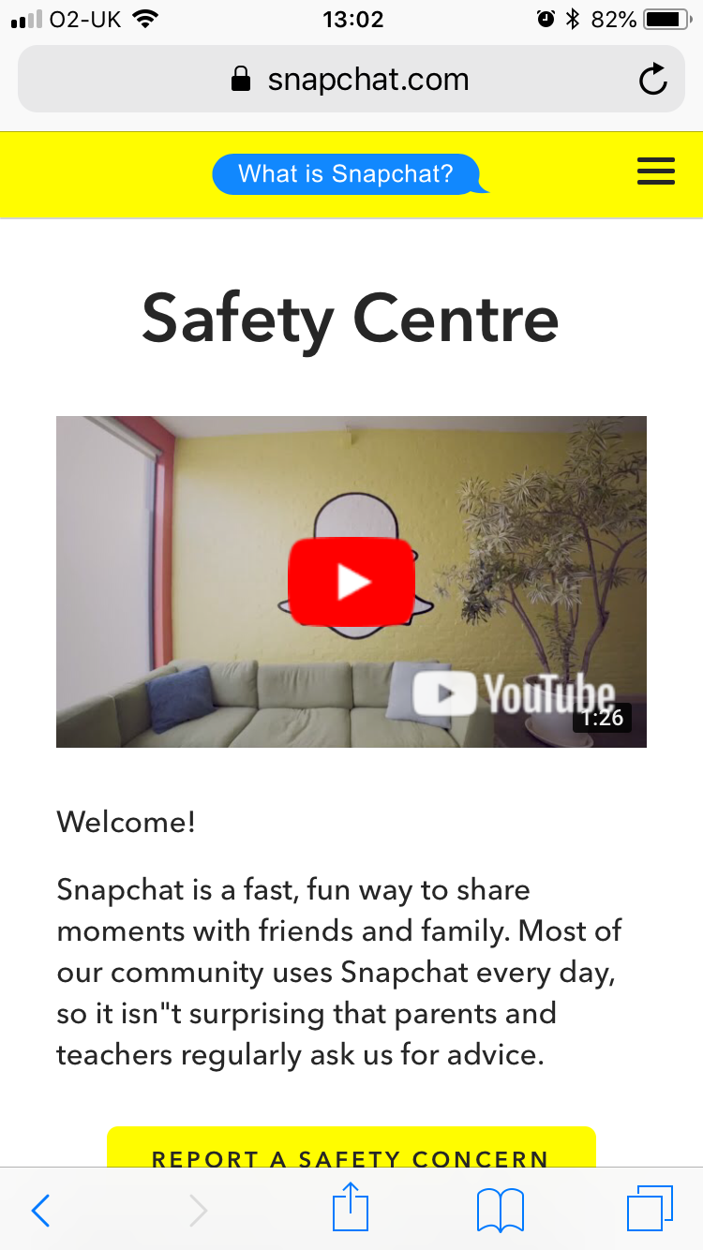
“For Parents” – Snapchat
Google: Snapchat
Select link pointed to ‘www.snapchat.com’
Scroll down
Click on ‘Community’
Select ‘Safety Centre’
Scroll down

Slide 27
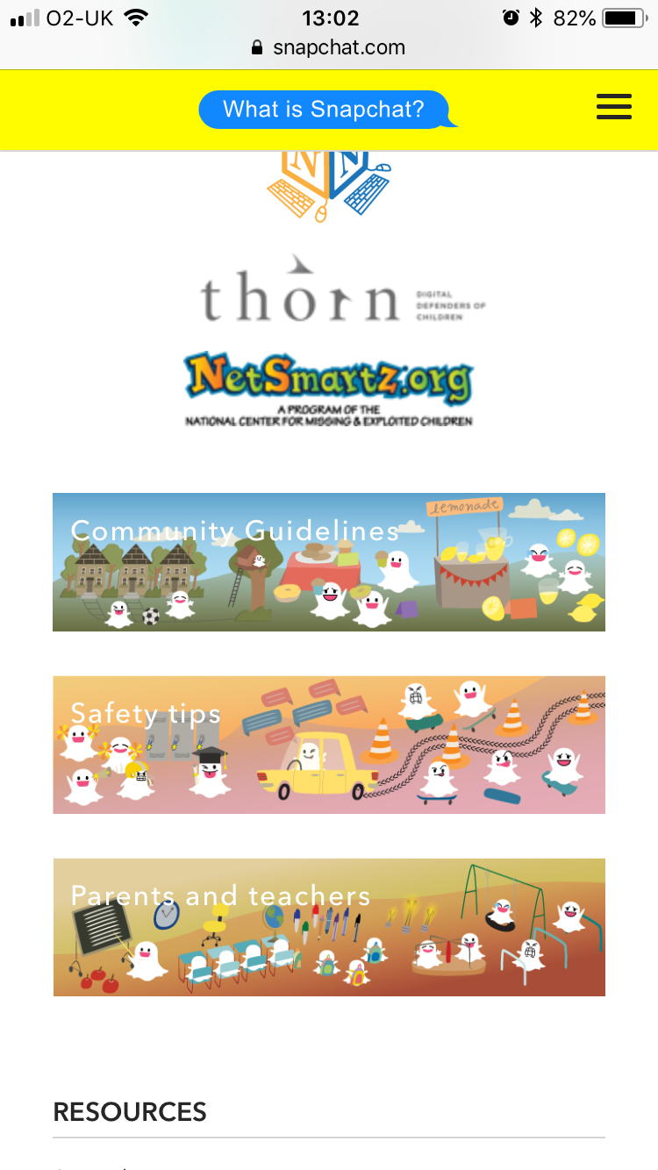
“For Parents” – Snapchat
Google: Snapchat
Select link pointed to ‘www.snapchat.com’
Scroll down
Click on ‘Community’
Select ‘Safety Centre’
Scroll down
Select ‘Parents and teachers’

Slide 28
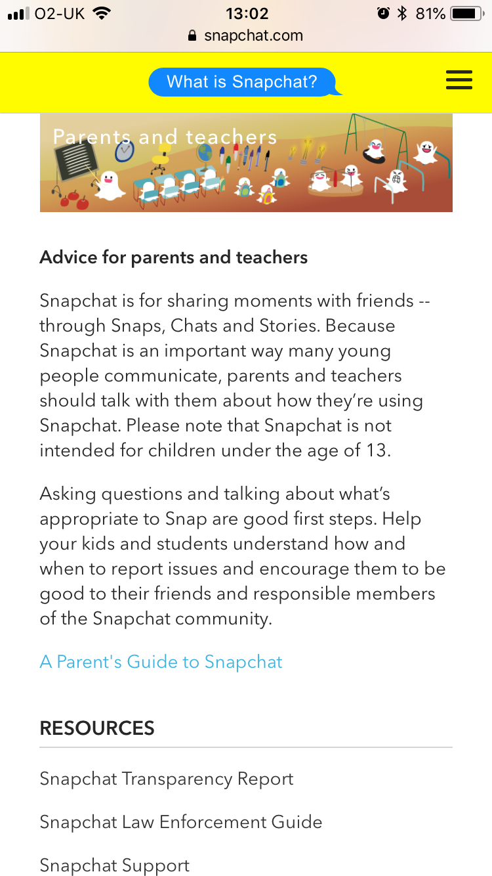
“For Parents” – Snapchat
Google: Snapchat
Select link pointed to ‘www.snapchat.com’
Scroll down
Click on ‘Community’
Select ‘Safety Centre’
Scroll down
Select ‘Parents and teachers’
Select ‘A Parent’s Guide to Snapchat’

Slide 29
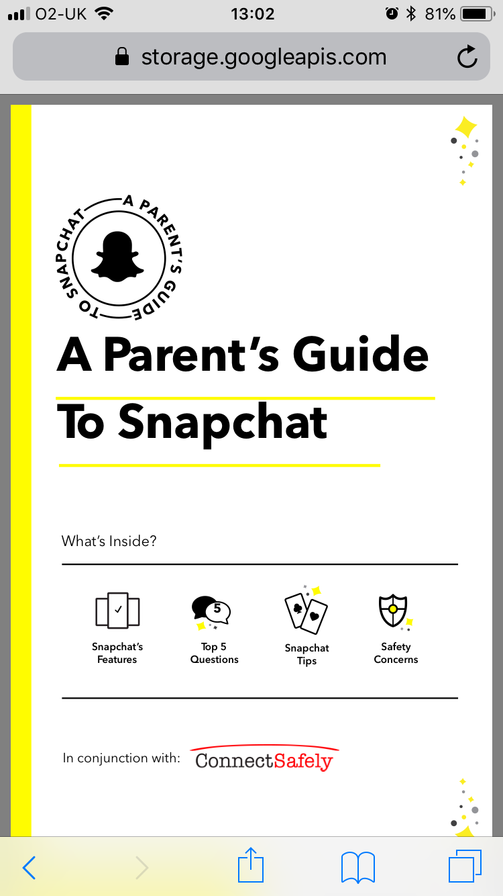
“For Parents” – Snapchat
Google: Snapchat
Select link pointed to ‘www.snapchat.com’
Scroll down
Click on ‘Community’
Select ‘Safety Centre’
Scroll down
Select ‘Parents and teachers’
Select ‘A Parent’s Guide to Snapchat’
Bookmark page

Slide 30
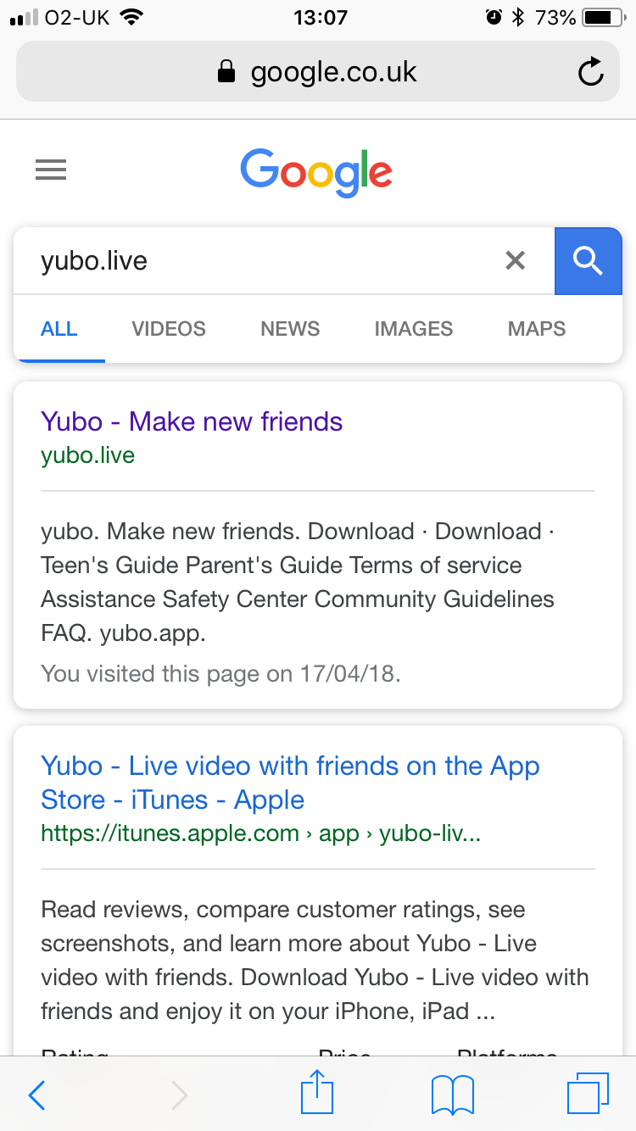
“For Parents” – Yubo formerly Yellow
Google: ‘Yubo.live’
Select link pointed to ‘yubo.live’

Slide 31
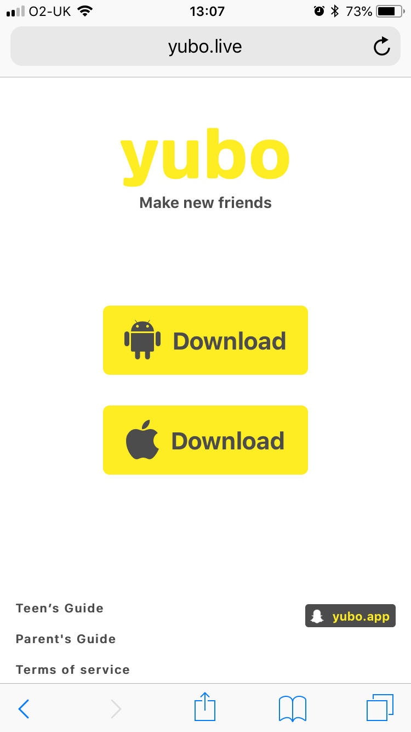
“For Parents” – Yubo formerly Yellow
Google: ‘Yubo.live’
Select link pointed to ‘yubo.live’
Select ‘Parent’s Guide’

Slide 32
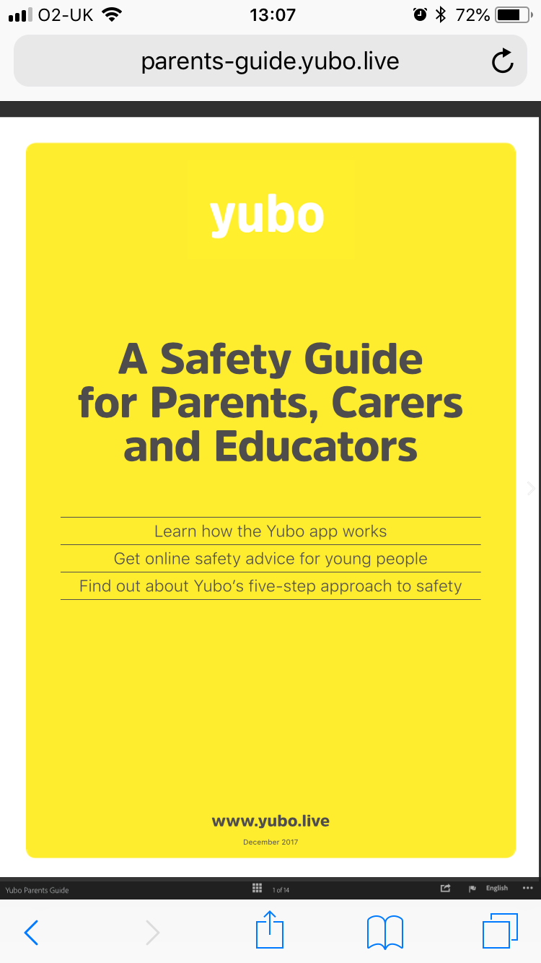
“For Parents” – Yubo formerly Yellow
Google: ‘Yubo.live’
Select link pointed to ‘yubo.live’
Select ‘Parent’s Guide’
Bookmark page

Slide 33
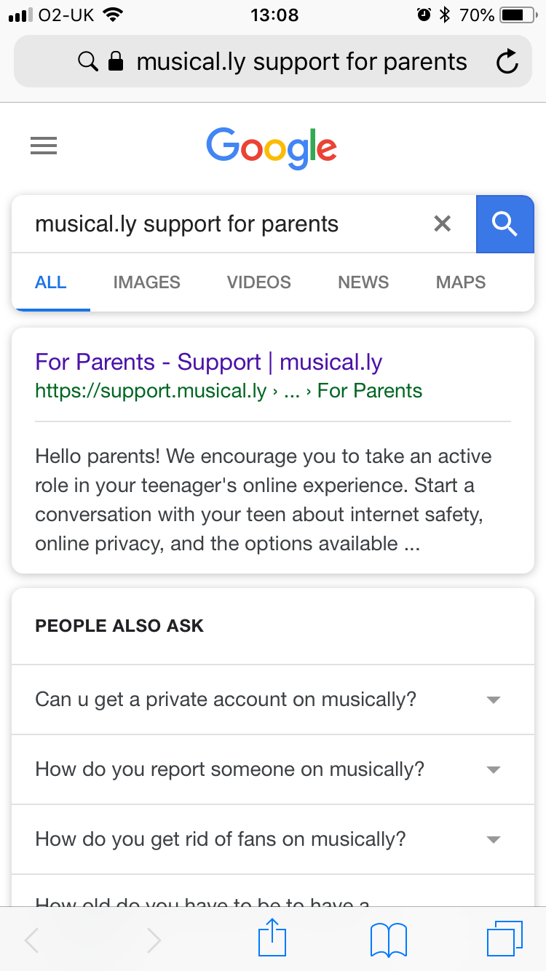
“For Parents” – Musical.ly
Google: ‘Musical.ly support for parents’
Select link pointed to ‘support.musical.ly’

Slide 34
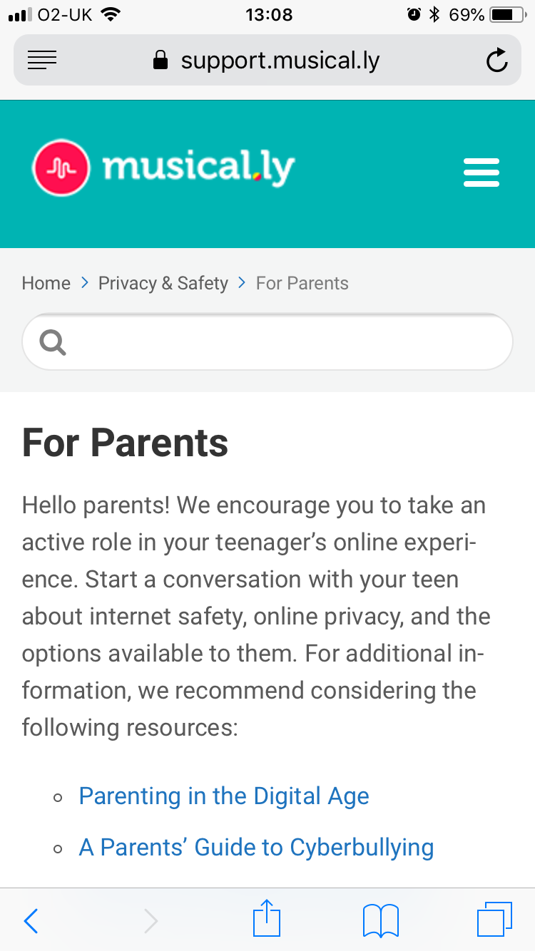
“For Parents” – Musical.ly
Google: ‘Musical.ly support for parents’
Select link pointed to ‘support.musical.ly’
Bookmark page

